Slide 1

SEPSIS SURVIVAL PREDICTION

Slide 2




Team - 12
Narsi Reddy Sanivarapu
Jagannath Patro Allupati
Vennala Kosanam
Siva Pavuluri
Data Analyst
Data Engineer
Data Scientist
ML Engineer

Slide 3



ABSTRACT
Sepsis is a potentially fatal condition characterized by the failure of several organs, resulting from an exaggerated immunological response to an infection.
The World Health Organization has designated sepsis as a global health priority and has called on governments to enhance their approaches to predicting, preventing, and managing sepsis.
To reduce the significant number of deaths and illnesses caused by sepsis and septic shock, it is necessary to enhance the accuracy of early-stage sepsis prediction. This study utilizes deep learning neural-network models to predict sepsis, using both structured and unstructured data.

Slide 4

Creating the value
Generating value is essential in several domains, including business, relationships, and personal growth.
Generating societal value often entails pioneering advancements that contribute to growth across several domains, including technology, healthcare, and education.

Slide 5
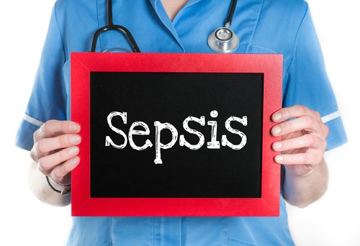
Challenge
Sepsis may result in a potentially fatal state. If not quickly recognized and treated, the mortality rate experiences a substantial rise. The diagnosis of sepsis might be difficult due to its non-specific symptoms that resemble those of other illnesses. Such circumstances might result in the postponement or failure to identify medical conditions, hence affecting the results for patients.

Slide 6

solution
Invest in and adopt advanced monitoring technologies that can help in early detection of sepsis. This includes continuous monitoring of vital signs and utilizing predictive analytics.
Implement standardized protocols for the timely recognition and management of sepsis. This includes clear guidelines for healthcare providers on diagnosis and treatment.

Slide 7

Technologies
Data Collection and Storage
Data Preprocessing using Python
Machine Learning and Predictive modeling
Validation and Evaluation
Deployment
Continuous monitoring and updating

Slide 8
3 C’S
1. Curiosity
2. Connections
3. Creating Value
This might be driven by a general interest in healthcare, medical advancements, or a desire to comprehend the nuances of sepsis prediction.
The interest may arise from a desire to establish connections between several facets of sepsis, including its frequency, difficulties in early identification, and the possible influence of prediction models.
Exploring the relationships between various parts may lead to a more comprehensive comprehension of the topic matter.
The motivation to create a sepsis survival prediction presentation likely involves a focus on creating value.
This could mean contributing to healthcare improvements, aiding medical professionals in decision-making, or enhancing patient outcomes.
The goal is to provide valuable insights and information through the presentation.

Slide 9
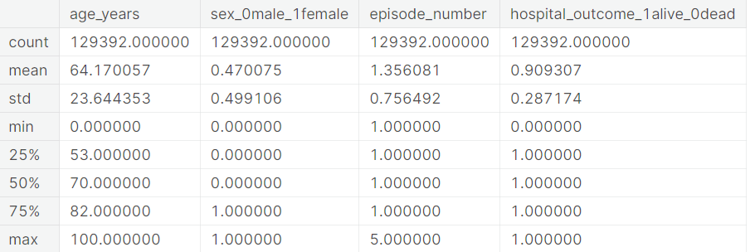
basic statistical operations in numeric columns

Slide 10
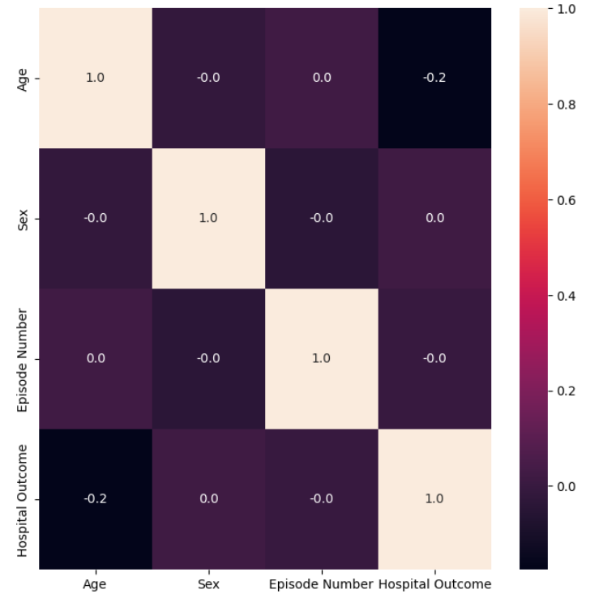
heatmap of correlation between all columns

Slide 11
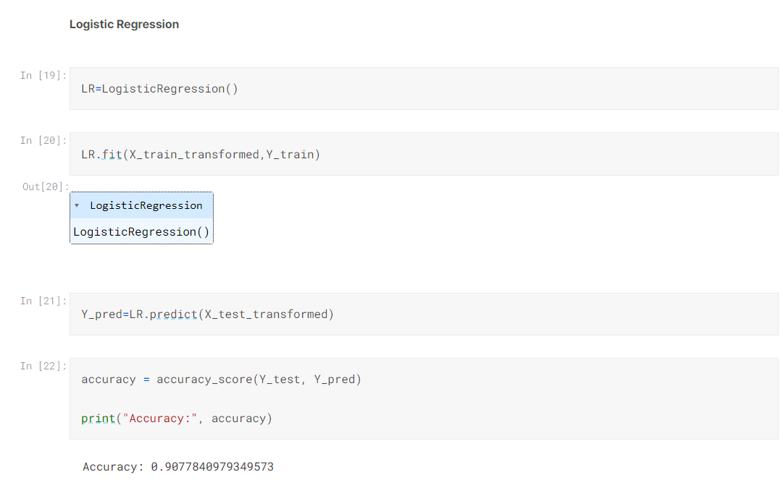
Accuracy – Logistic Regression

Slide 12
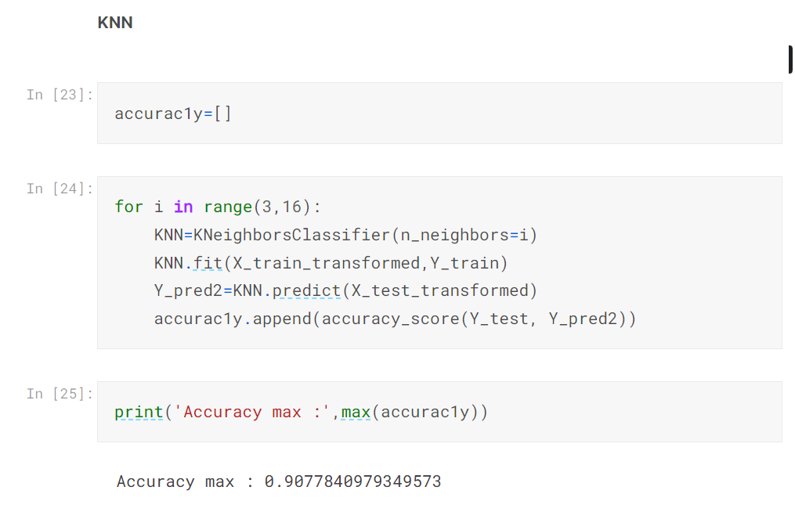
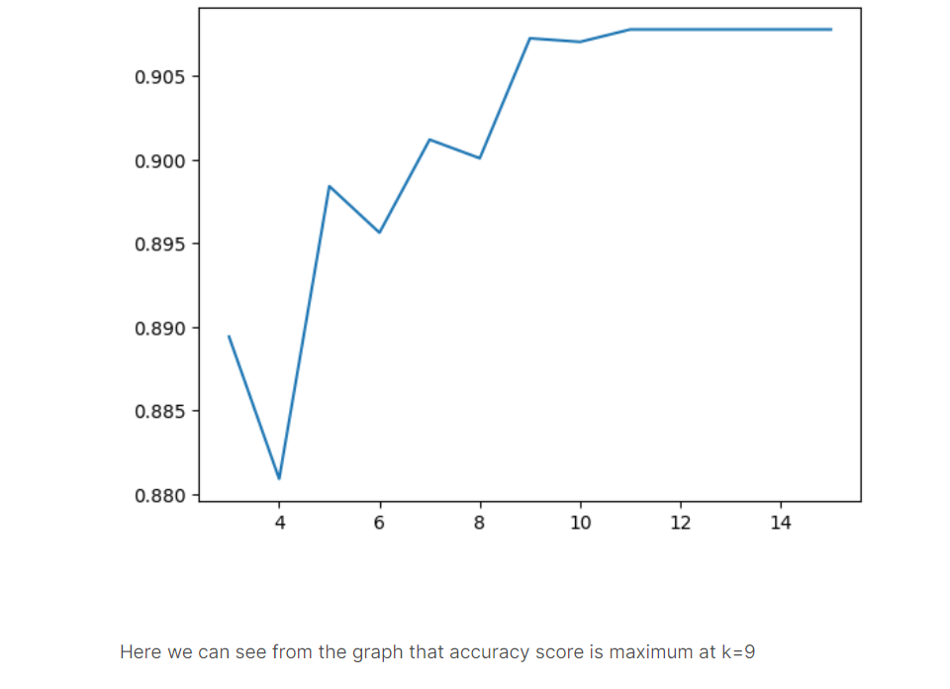
Accuracy – Knn

Slide 13
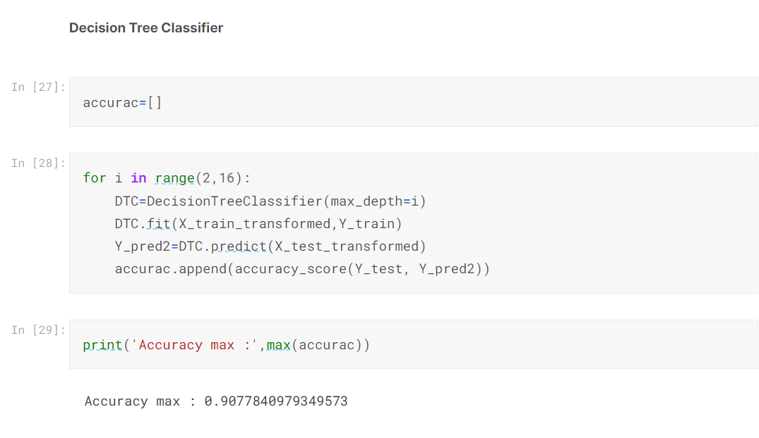
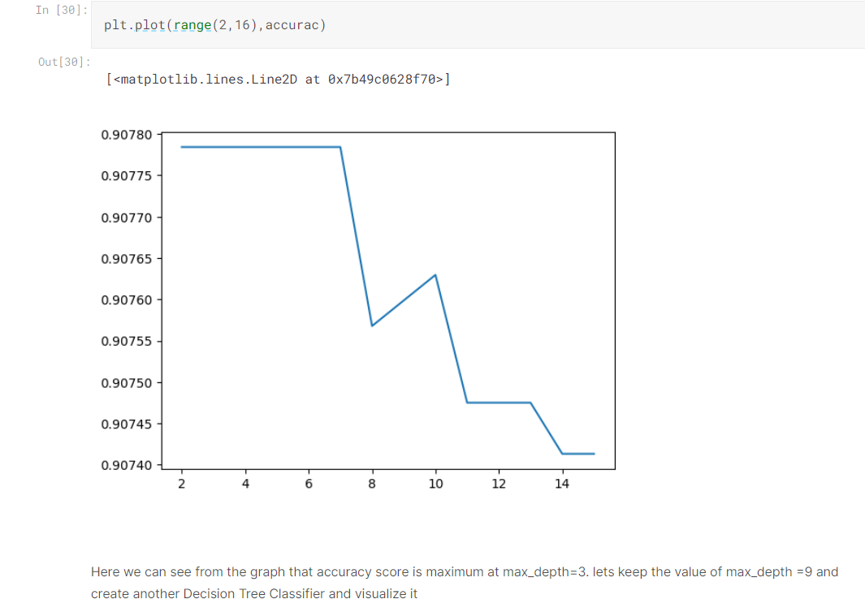
Accuracy – Decision tree classifier

Slide 14
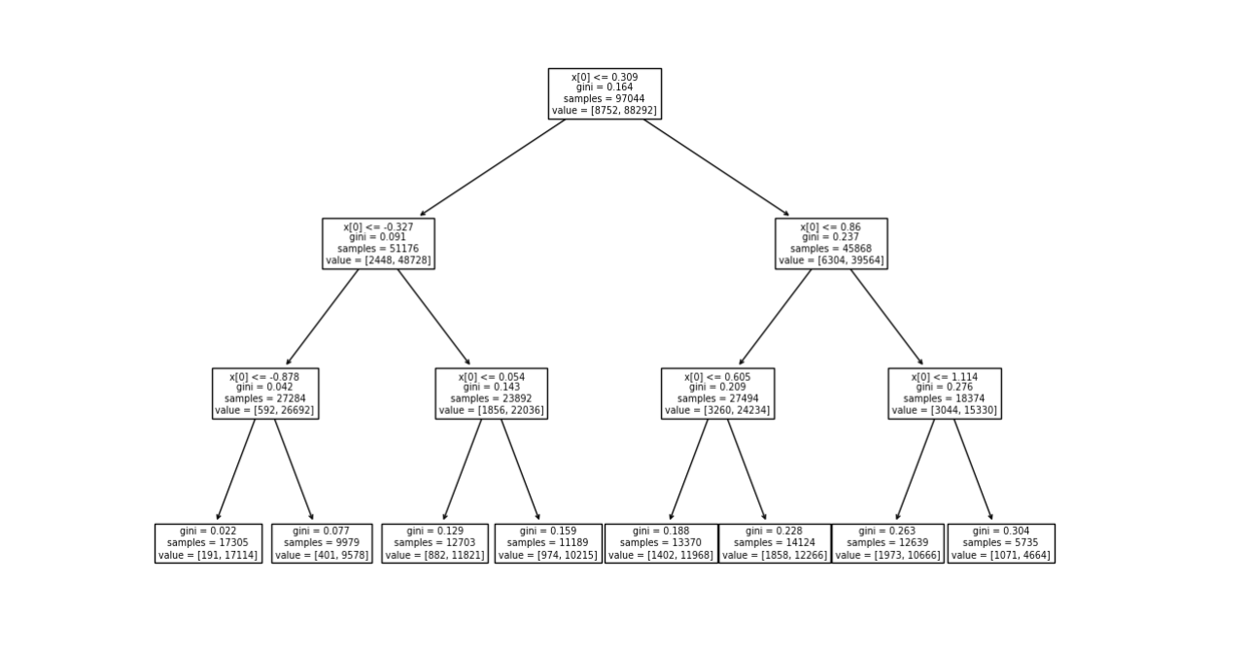
Decision tree
This shows us the decision taken by the algorithm based on the features for the data which is used.

Slide 15

Thank you

